Slide 1
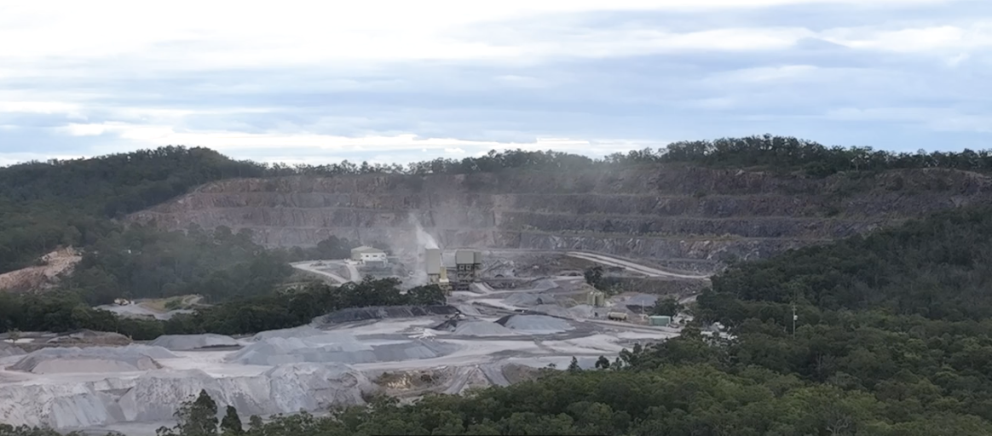
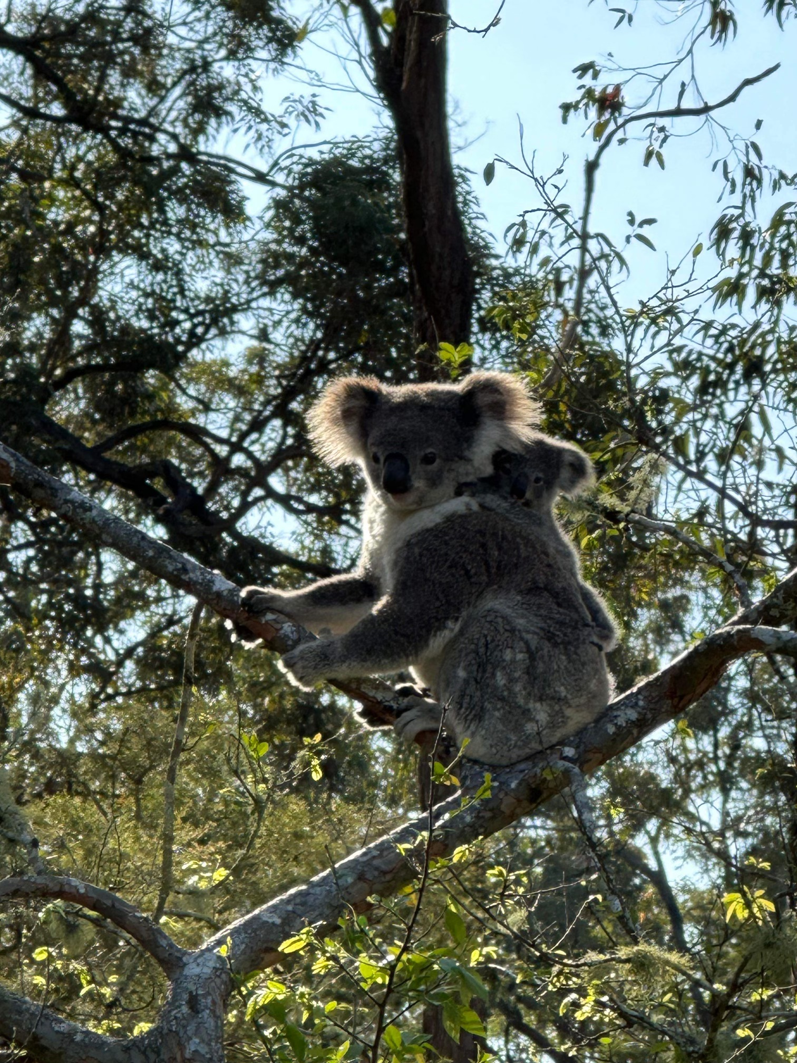
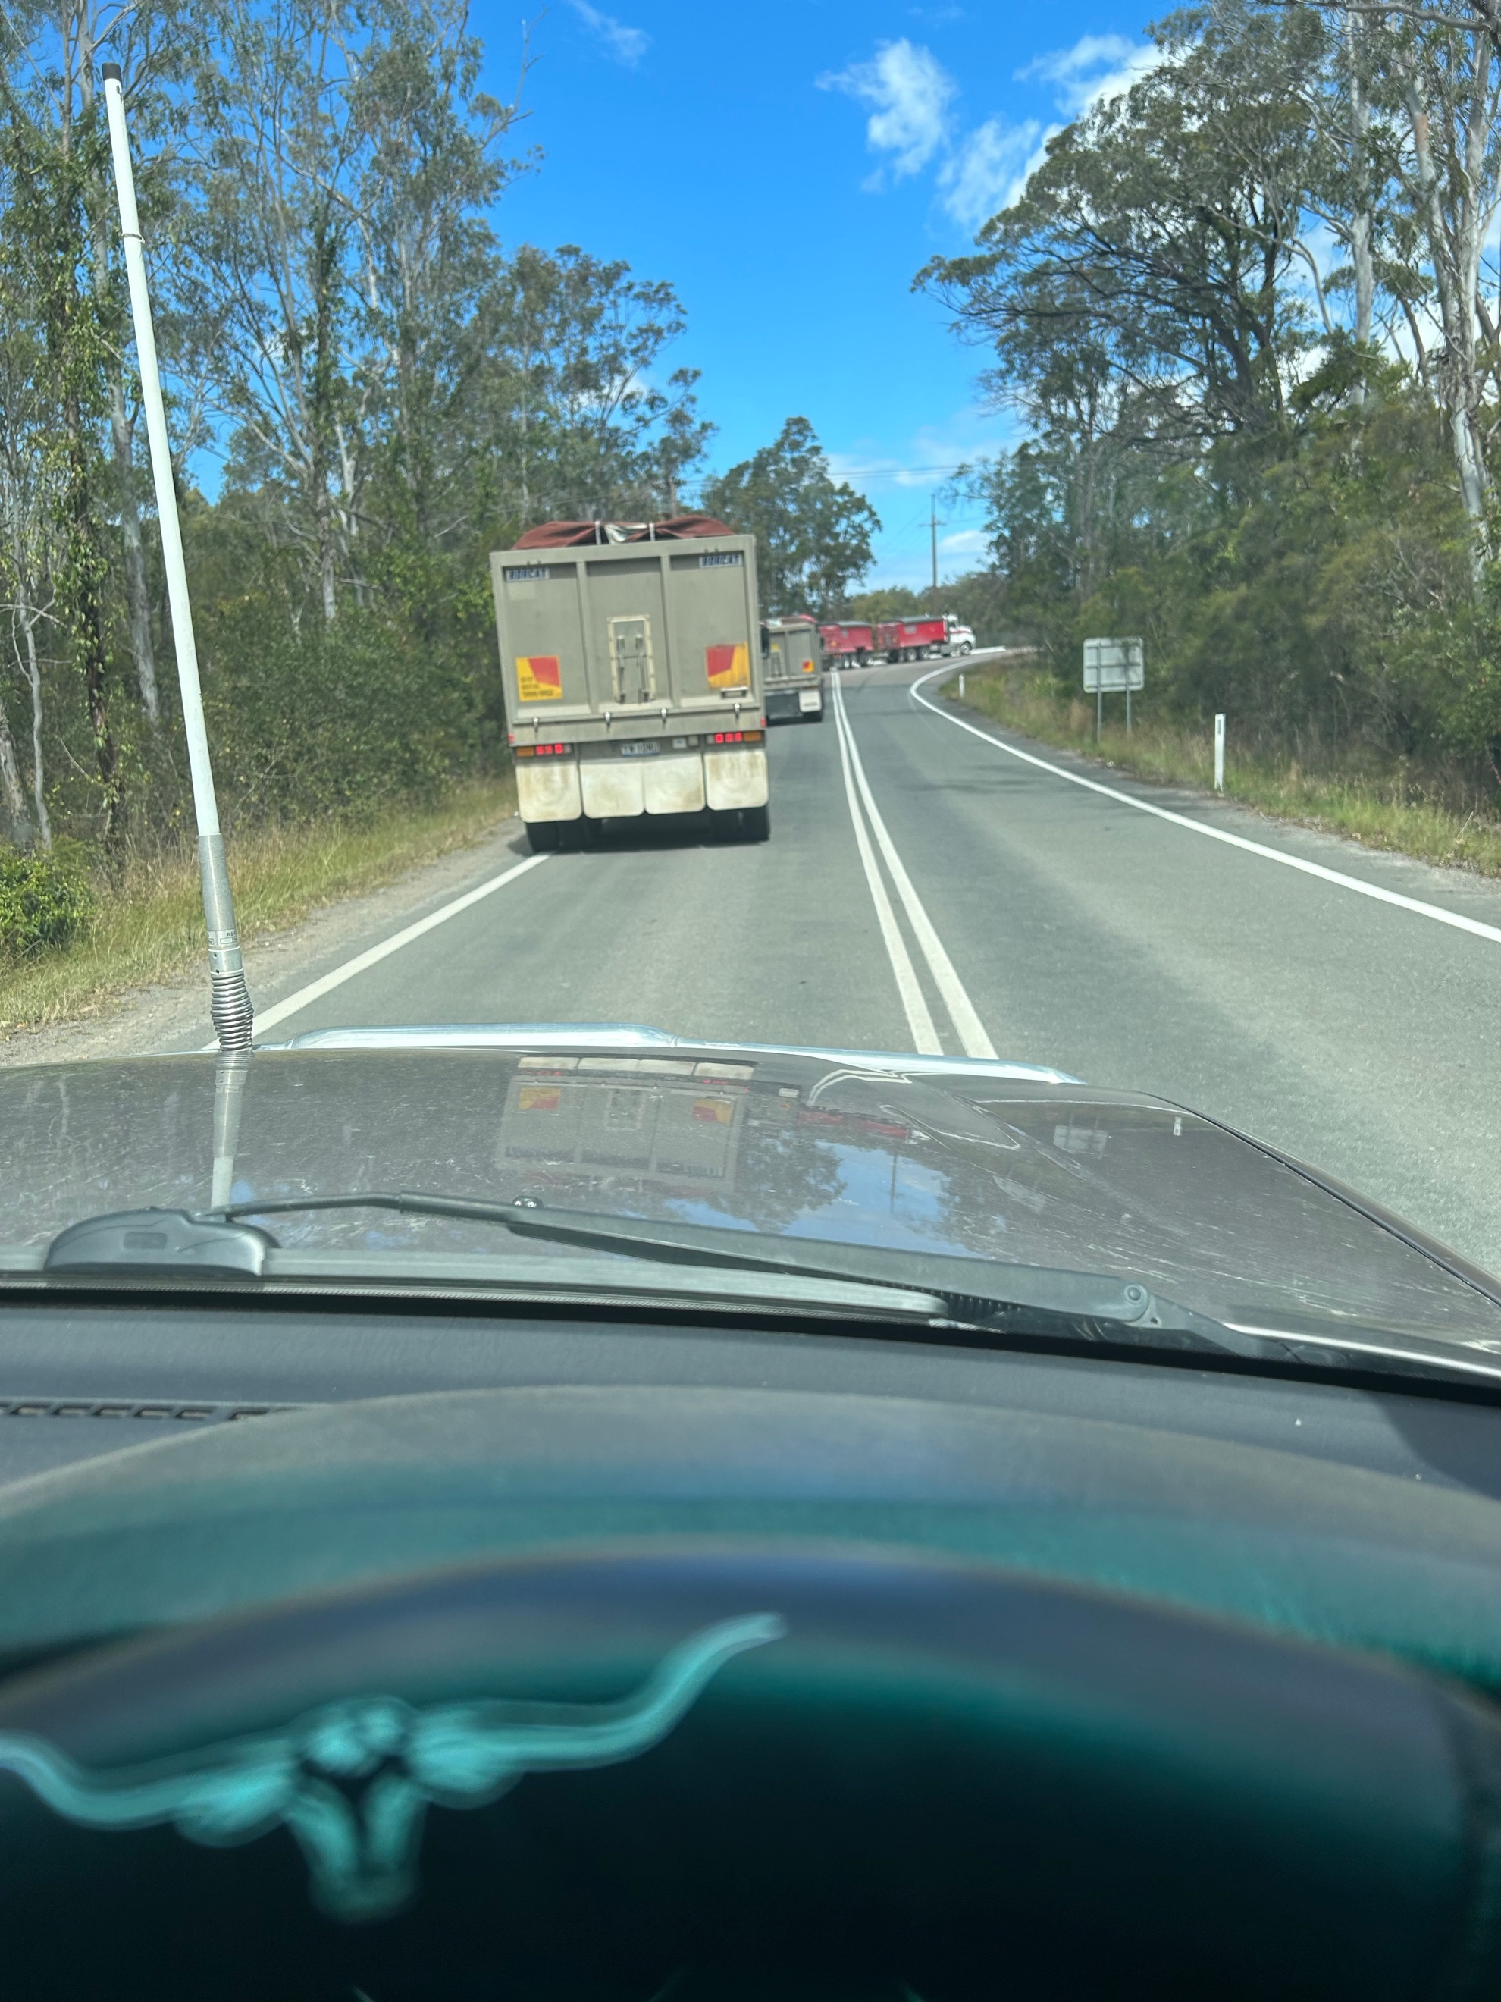
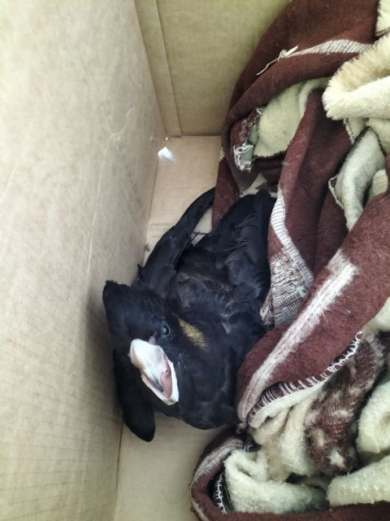
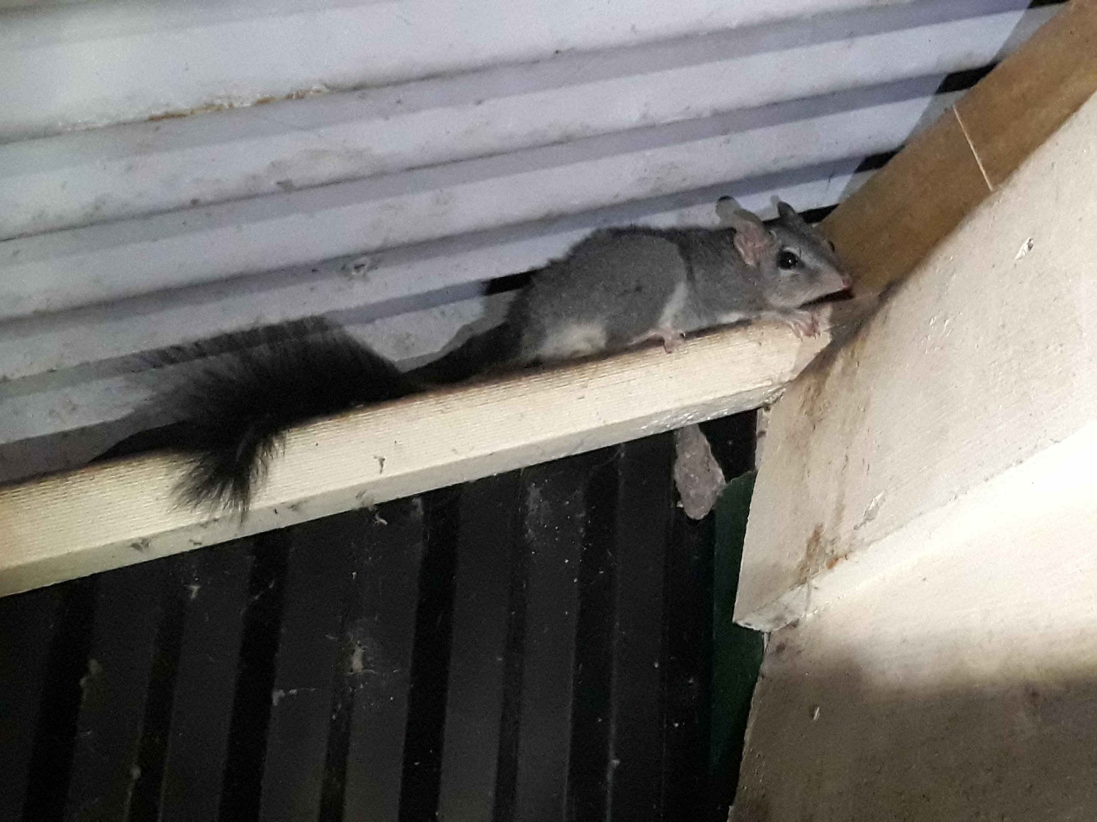
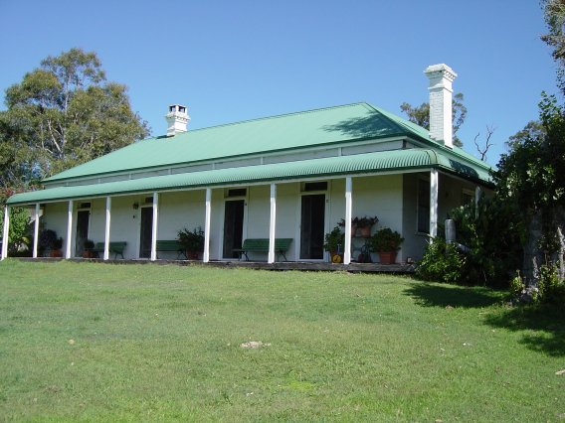
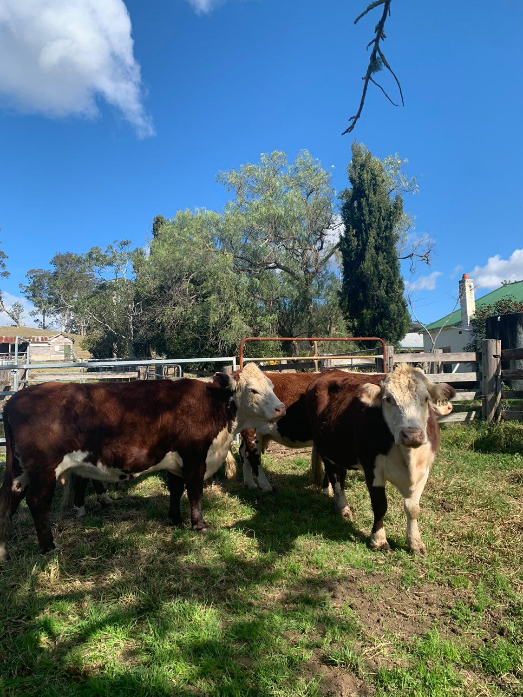
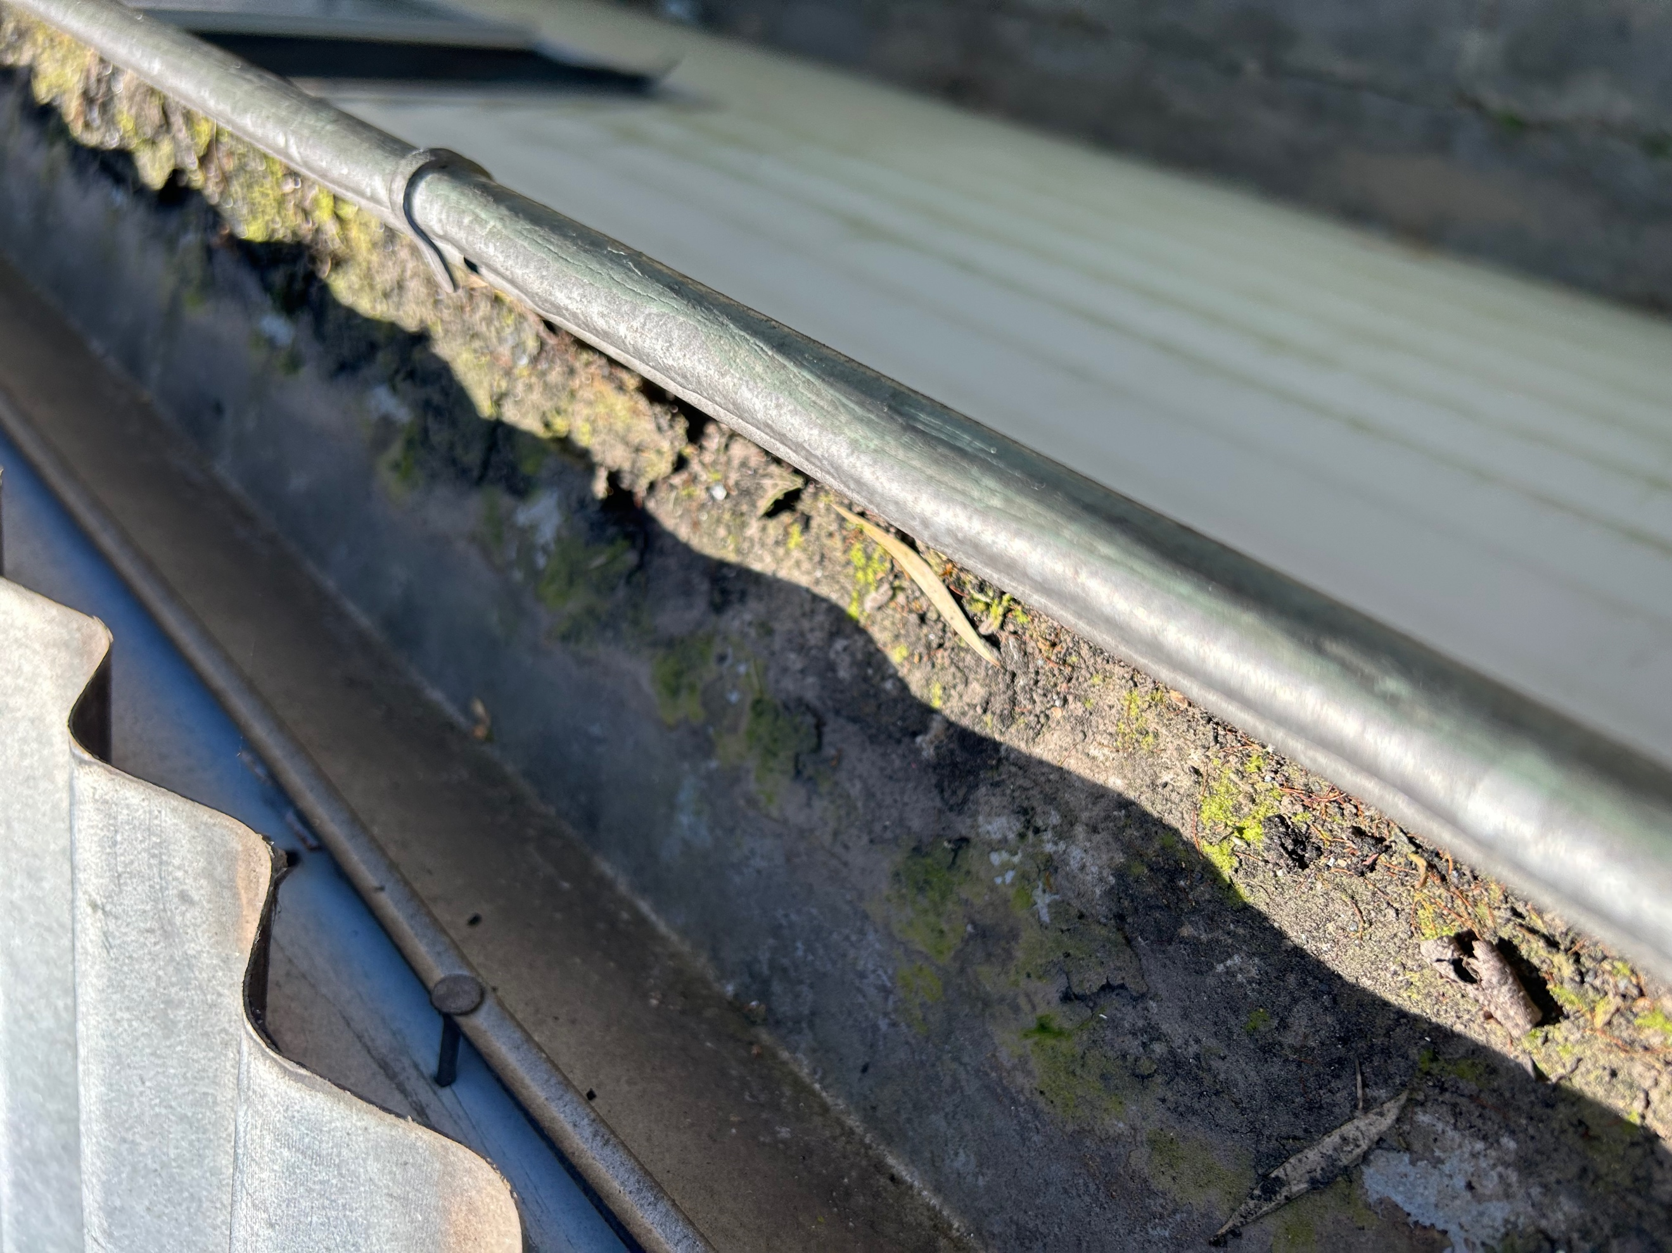
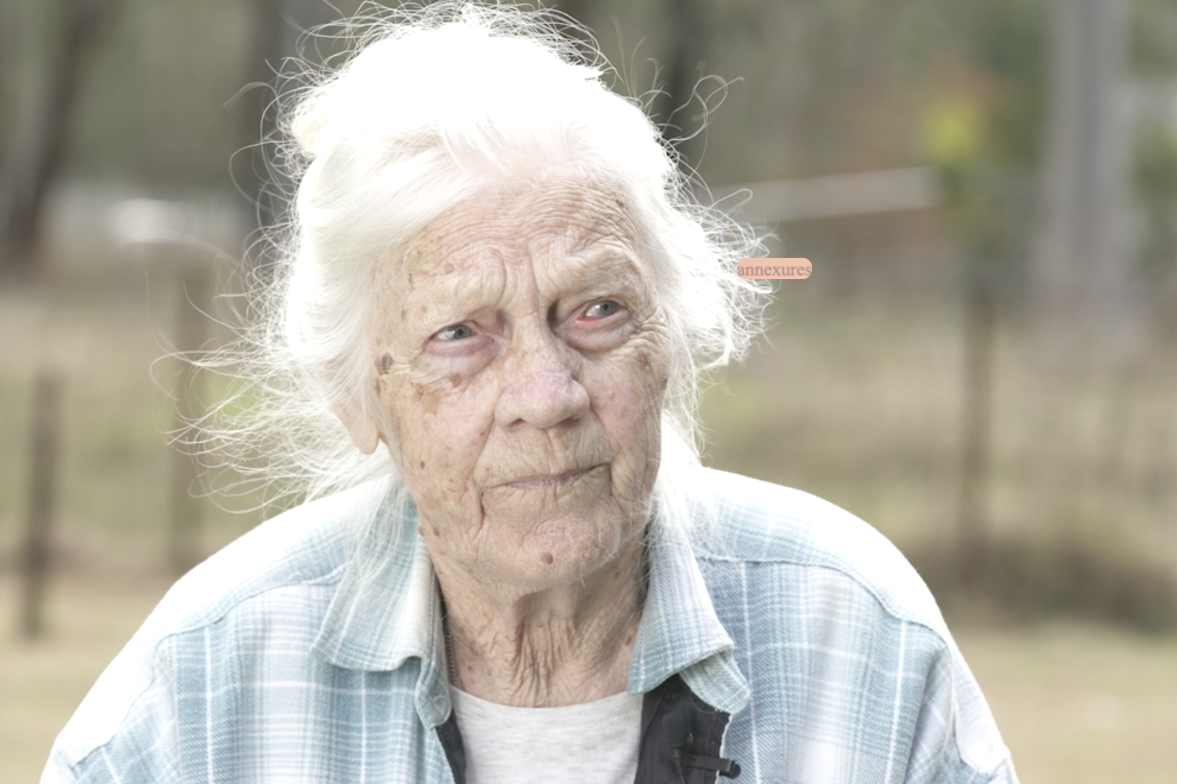
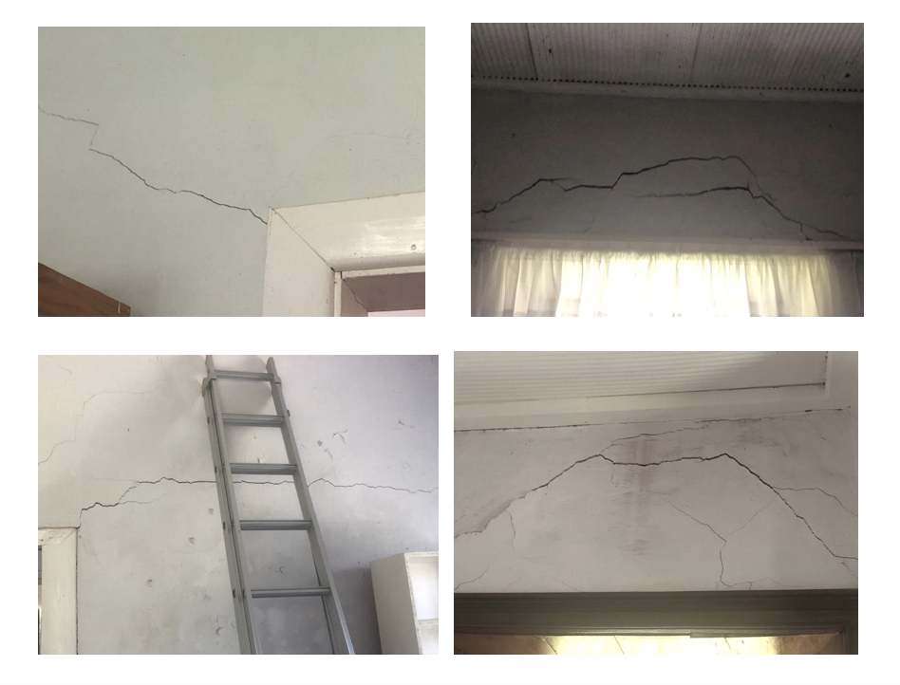
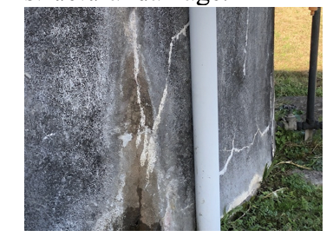
Eagleton Quarry – a mistake in the planning
Presentation to the Independent Planning Commission
by Save Balickera Inc.

Slide 2
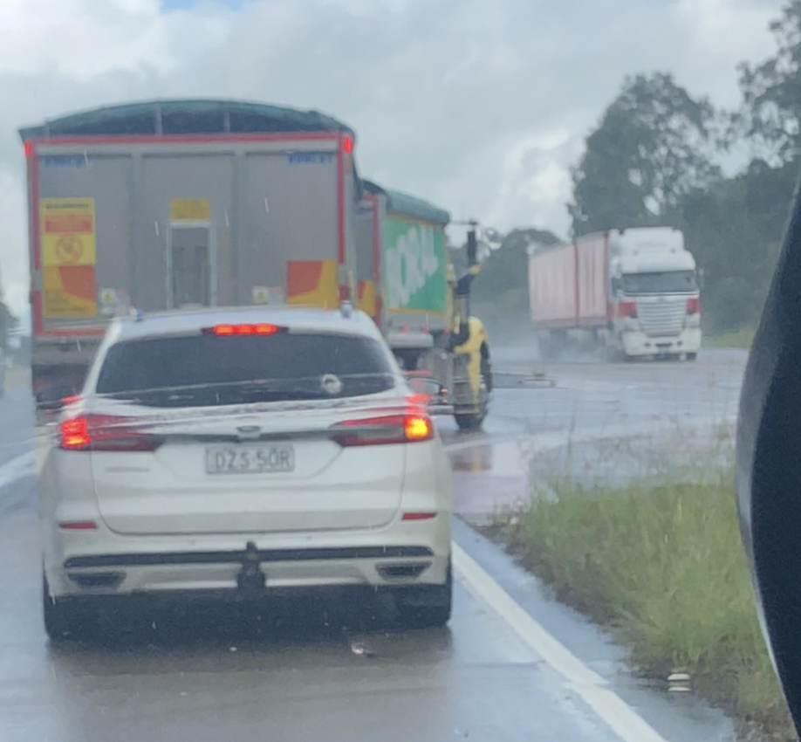
Truckin’ life on Italia Road
Resident took this when waiting to turn from Italia Road onto Pacific Highway – there is typically a queue of trucks turning right. Old habits will be hard to change and self-monitoring is unlikely to be reliable. Residents cannot be expected to police this – very difficult to catch truck details while focused on driving.
Taken May 2024 by writer – waiting to turn right off Pacific Highway into Italia Road –
again a queue of quarry trucks plus oncoming trucks to avoid and more Boral trucks turning right out of Italia Road (not all captured in shot) . This dangerous right turn will not be addressed by plans for intersection upgrade. Only a matter of time before there is a catastrophic accident. Request for dispensation on haulage contributions is outrageous considering cost to the community.

Slide 3
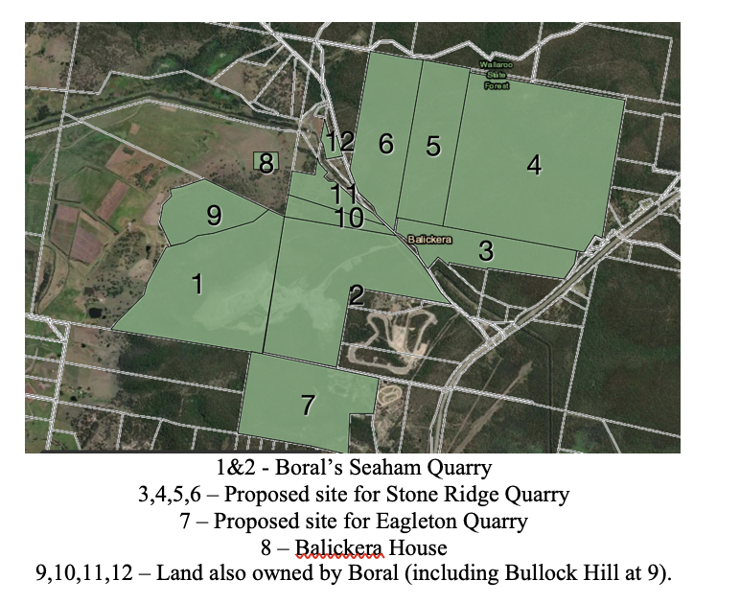
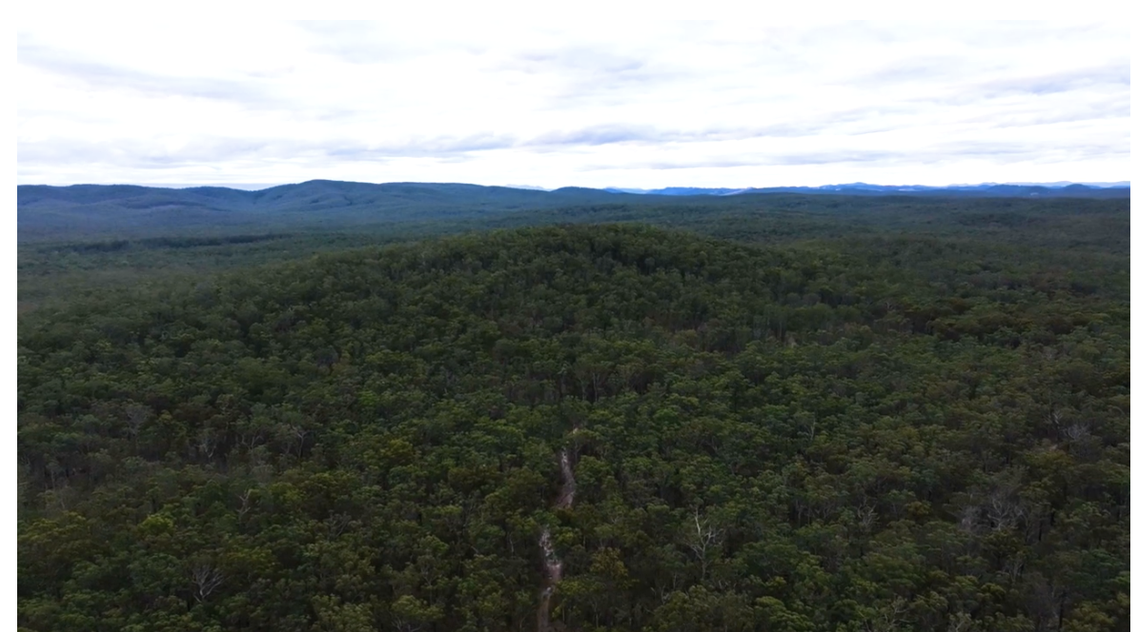
Balickera - from heritage farm and bush idyll to super quarry

Slide 4
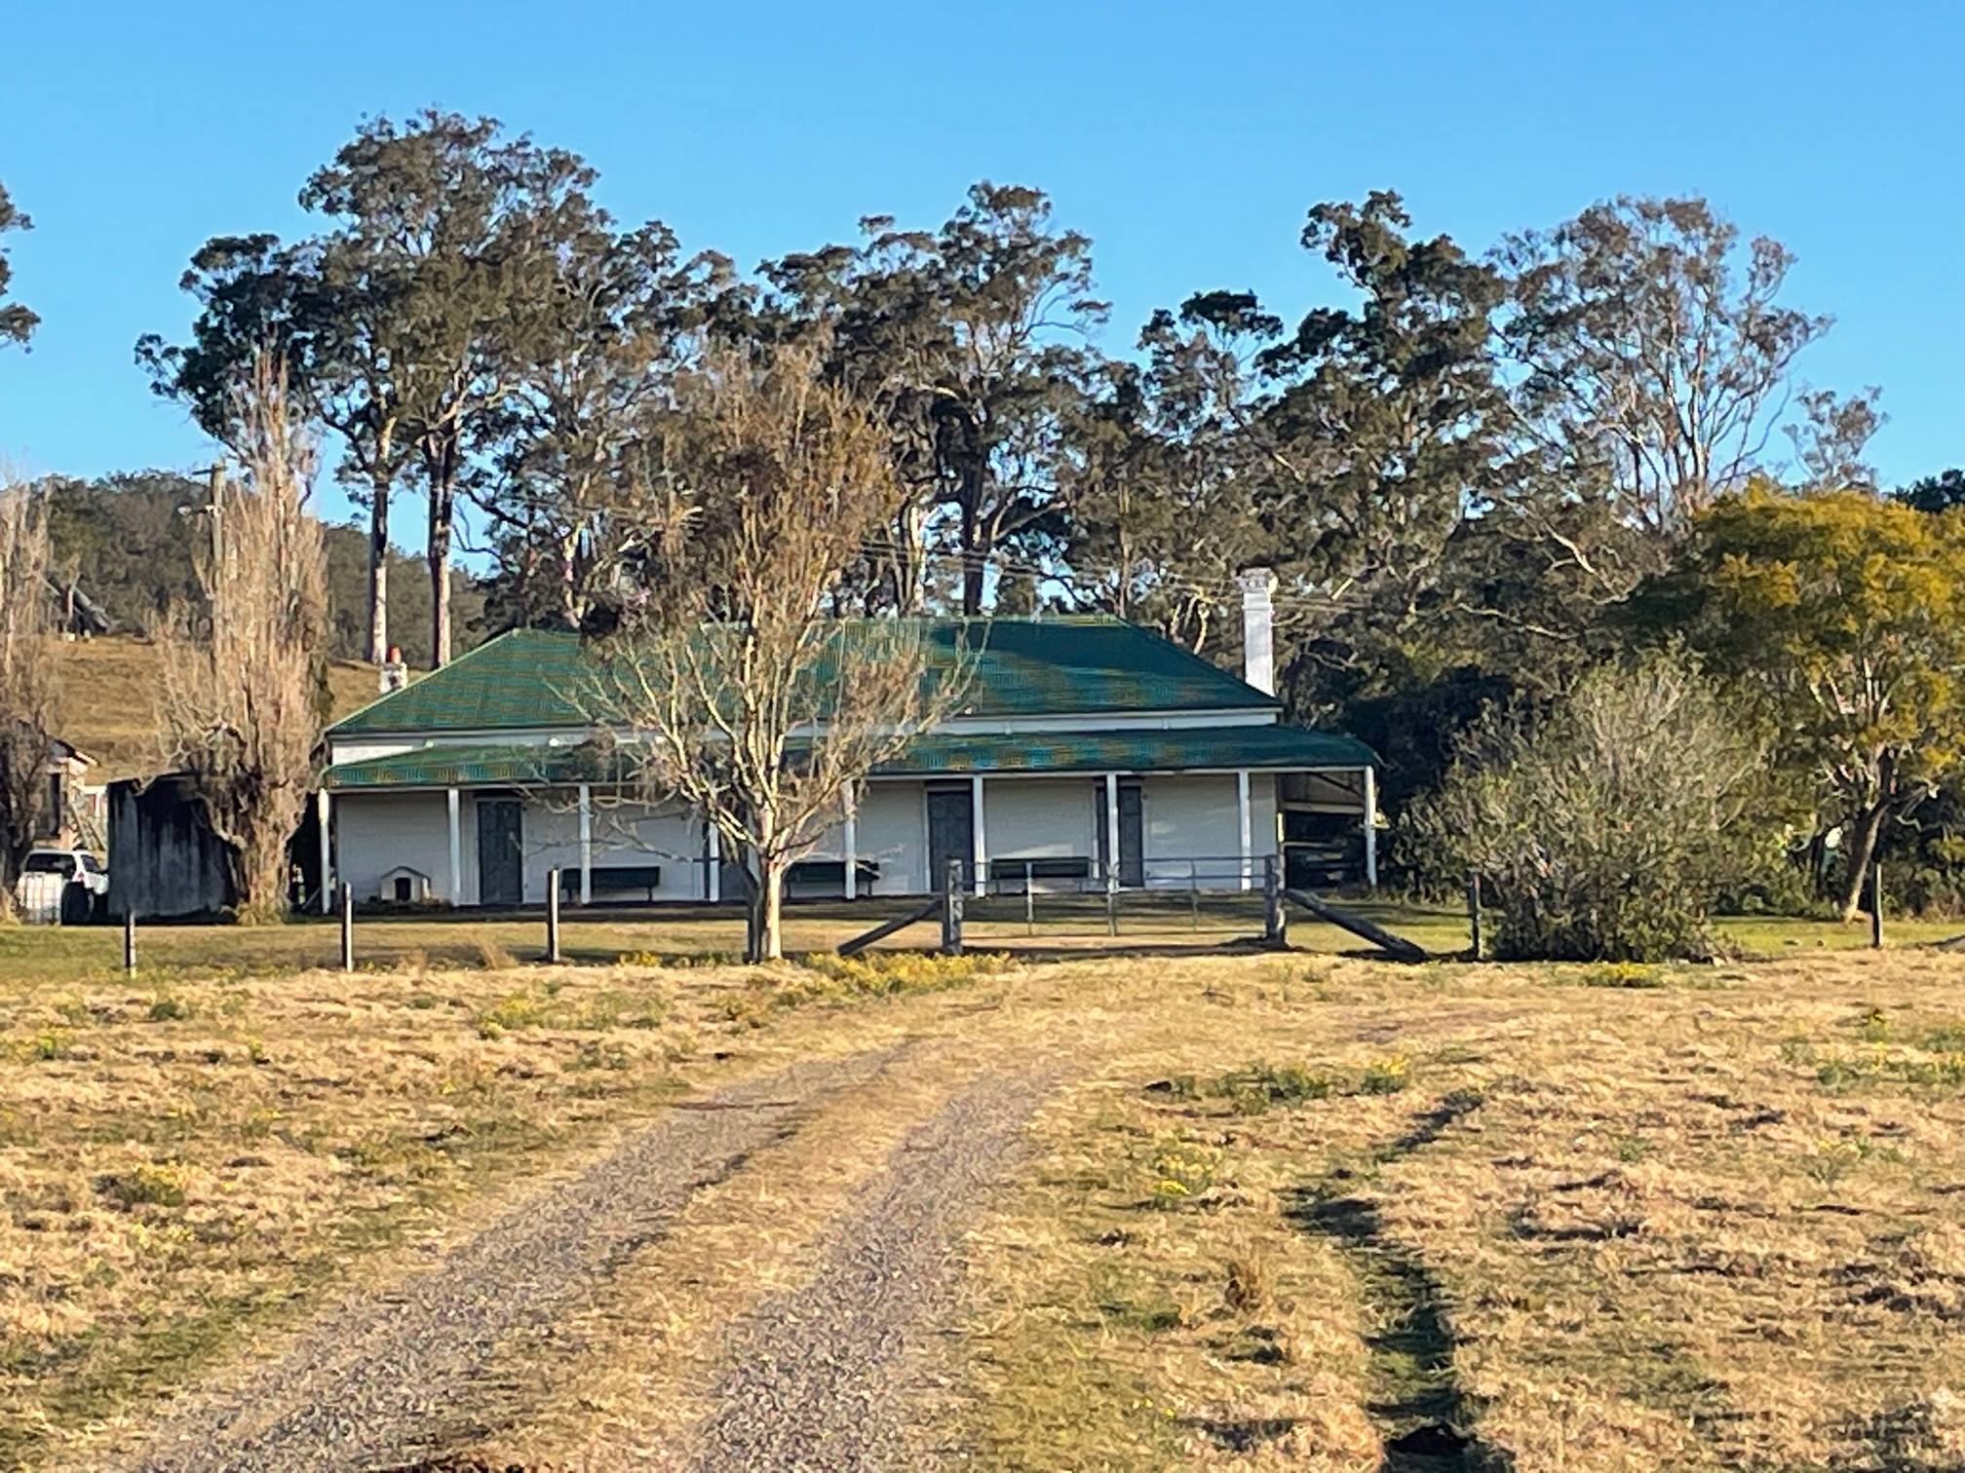
Heritage impacts? Balickera house and farm – completely ignored. What community consultation? What monitoring? What consideration of cumulative impacts?

Slide 5
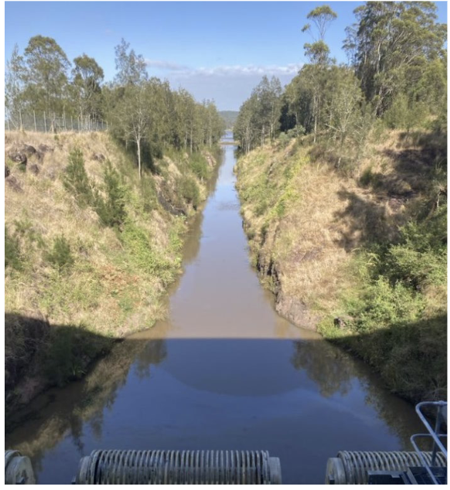
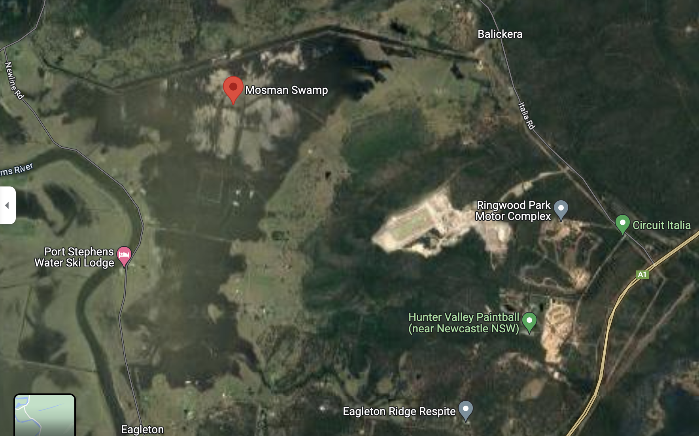
Impacts on Air and Water –
What community consultation? What monitoring? What health studies? What consideration of cumulative impacts?

Slide 6


Harm to environment and biodiversity will not be mitigated by environmental offset scam.

Slide 7
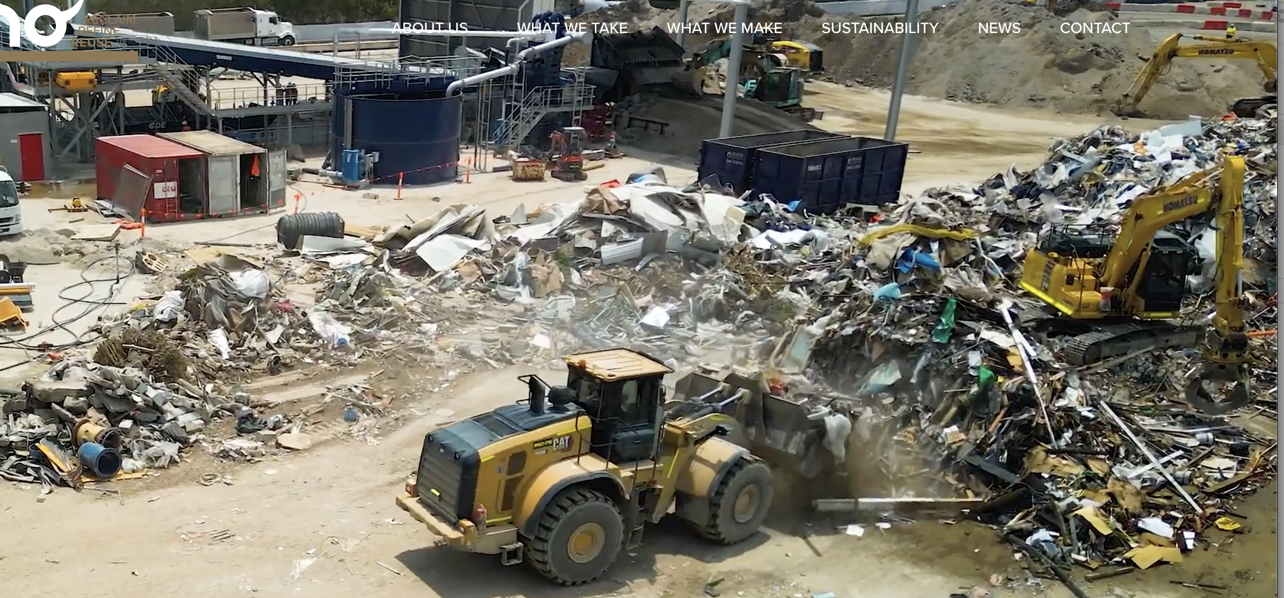
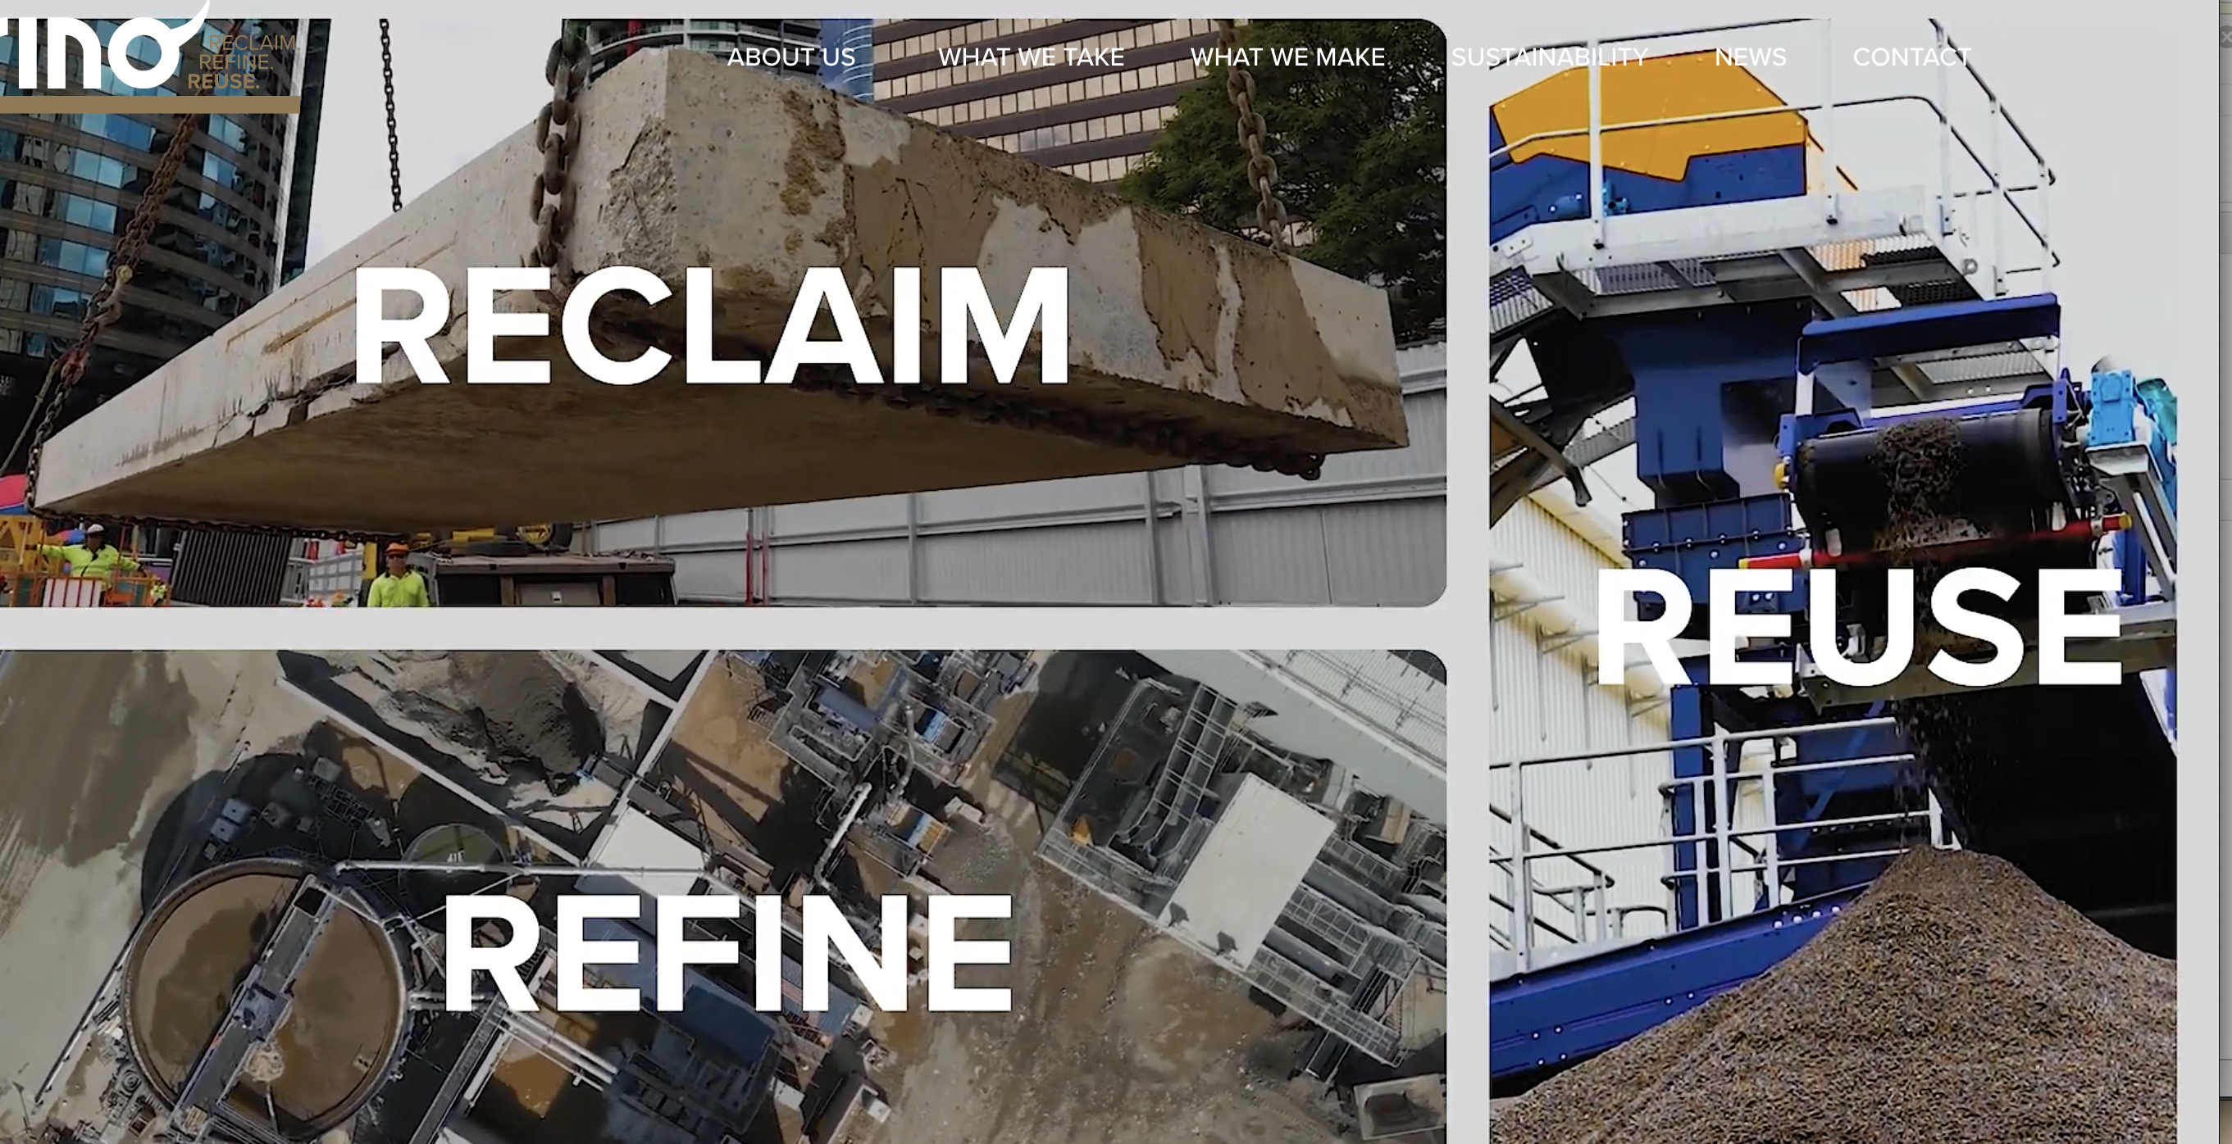
Alternatives not explored

Slide 8
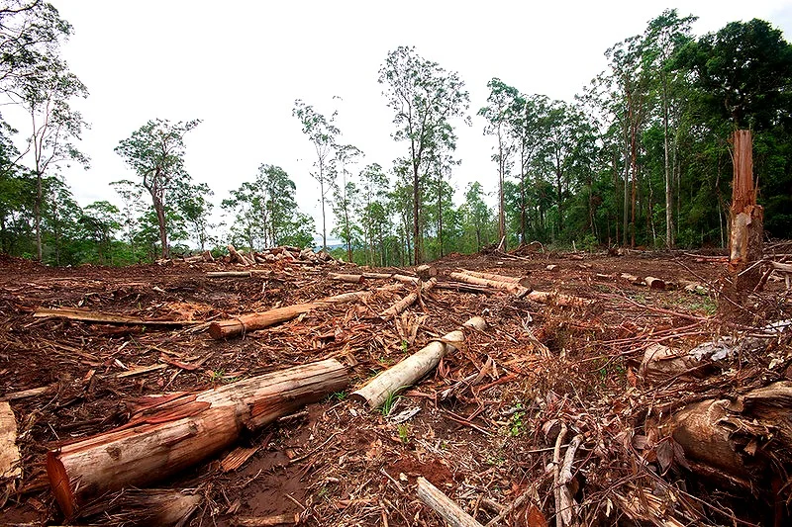
Australia’s commitment to halt deforestation by 2030 and net zero targets.
Currently Australia is the only developed nation on the list of global deforestation fronts.
Australia has recently joined the Forests and Climate Leaders Partnership and signed the Glasgow Declaration commiting to halting deforestation by 2030.
All levels of government must act consistently with these international obligations.

